Slide 1
Surface Area
Year 9
Week 6
Lesson 1

Slide 2
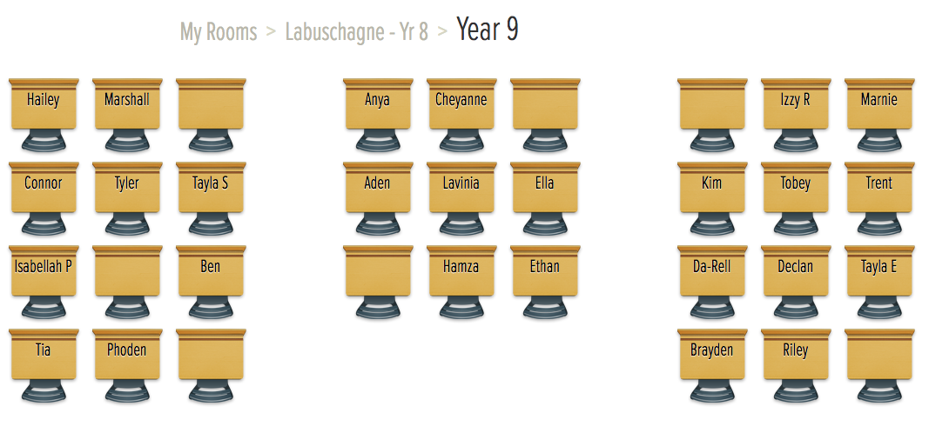

Slide 3

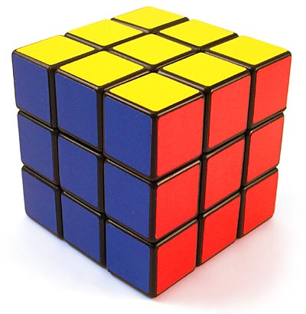

Beginning of the Lesson
What do all these objects have in common?
They are 3-D
Notes:
• Link to past experiences or knowledge of the students
• Actively involve the students
• Relevant to the objective of the upcoming lesson

Slide 4
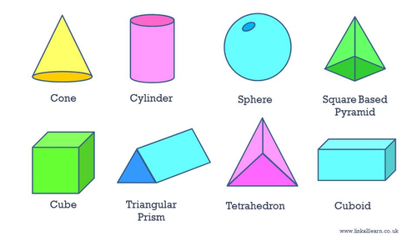
Lesson Objectives
How to find the surface area of 3-D shapes
Notes:
• Share with students what they are learning or will be able to do
• Why the lesson is important

Slide 5
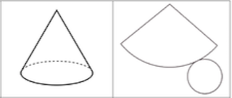
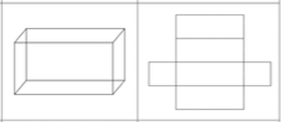
24
7
30
Topic: Surface Area
Date
EQ – How do you calculate the surface area of different shapes?
A net is a two-dimensional illustration of all the surfaces of a solid
Net
Solid Net

Slide 6
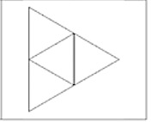
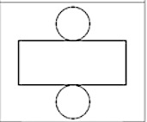
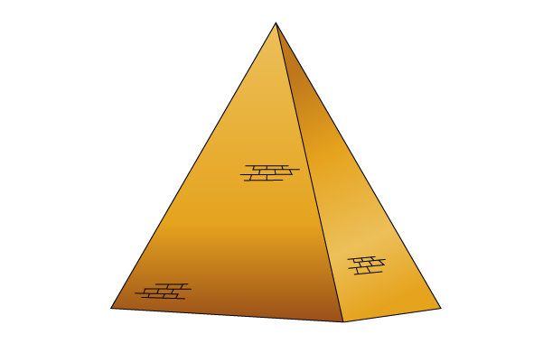

24
7
30
Topic: Surface Area
Date
EQ – How do you calculate the surface area of different shapes?
Name of the solid shapes by looking at it’s net
Net
Pyramid
Cylinder

Slide 7
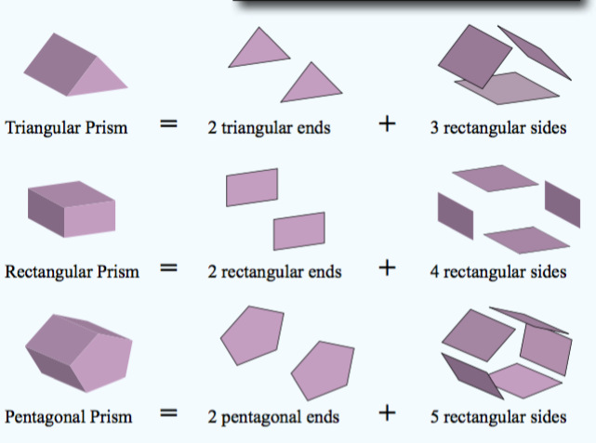
24
7
30
Topic: Surface Area
Date
EQ – How do you calculate the surface area of different shapes?
Prisms are solid, or hollow, objects with two identical ends and rectangular sides
Prism

Slide 8
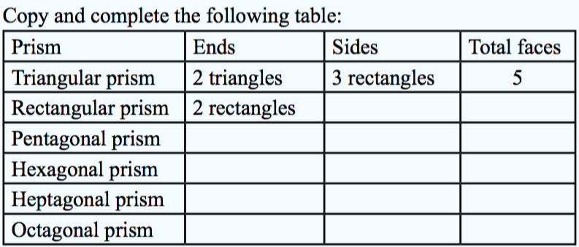
Task
4 rectangles
6
2 pentagons
5 rectangles
7
2 hexagons
6 rectangles
8
2 heptagons
7 rectangles
9
2 octagons
8 rectangles
10
Notes:
• Practise the skill
• Encouragement

Slide 9
Task
Make your own Prisms
cut along the lines
glues the sides together
Notes:
• Practise the skill
• Encouragement

